Slide 1
A Framework for a Better Framework
Richard Steinberg
Accessibility Associate, Wholesale Digital Engagement and Execution
Wells Fargo Digital Solutions for Business (DS4B)

Slide 2

Frameworks and You: Why Bother?
Notes:
Discuss my background in state government, the process of reinventing the wheel, the lack of resources. On any given day, we had 50 apps and as many campaign websites, each created and maintained by its own development team.
Those who like using a framework like Bootstrap or jQuery say that it helps you invest in the task, not in the technology without reinventing the wheel. A framework is not an absolute necessity, nonetheless it is very useful. And it’s a pledge of quality, upgradability, and maintainability of applications at lower cost.

Slide 3
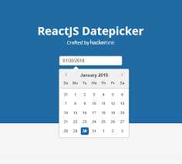
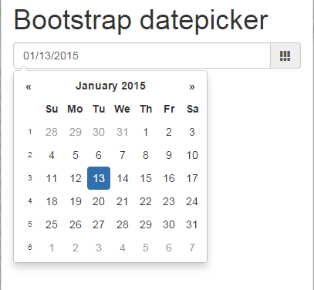
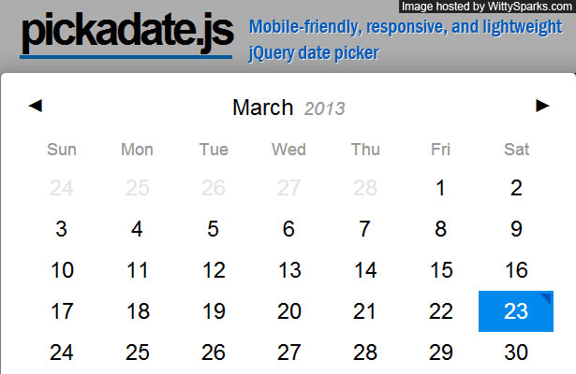
The Date Picker
Notes:
Let’s take a fairly complicated user interface component: The Date Picker. It comes in many shapes and colors, runs with different JavaScript libraries. There weren’t enough developers, QA testers, accessibility specialists, and designers in my previous organization to code, implement, and maintain all the date picker flavors, yet that’s exactly what we attempted to deal with. And although our small but dedicated accessibility team dealt with these one by one, it was an ongoing challenge. And that was only the date pickers that we knew of. There were sites and apps we never saw—some were rogue, some were abandon ware. And this is just for the Date Picker—there were many other user interface components.

Slide 4
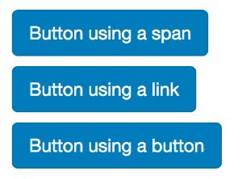
Drawback of Frameworks
Notes:
Unfortunately, a JavaScript library can create its own set of issues. As UX designer Russ Weakley points out, one of the downsides of a framework like Bootstrap is that it allows developers to code something as simple a button several ways. The Bootstrap button classes allow developers to make any element appear like a button even if these elements have no semantic meaning. Fake buttons might get announced as “buttons” by a screen reader but sometimes are not actionable. There are other issues too—like not having semantically coded headings that fall into a hierarchy, Sometimes developers only focus on the visual impact. Styling a span as a heading level 1 is not going to help assistive technology users.

Slide 5

Framework + Design = Win Win
Notes:
When you assemble a team comprised of people from different specialties, it’s a win win. Many organizations have what are called user experience teams and they consist of techies, designers, people who are concerned with content, interaction, accessibility, and research into what users want to experience on your site or application. The important thing is once your team is assembled, you can begin to work out the details for creating what is called a design system.

Slide 6
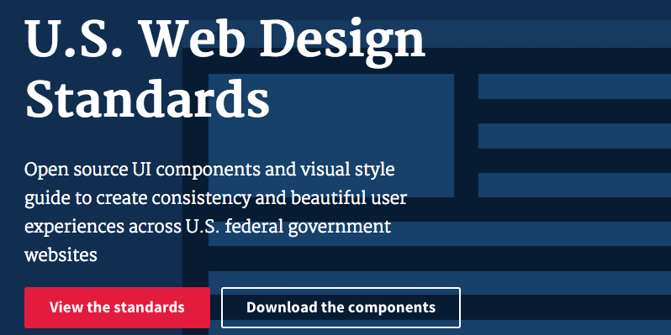
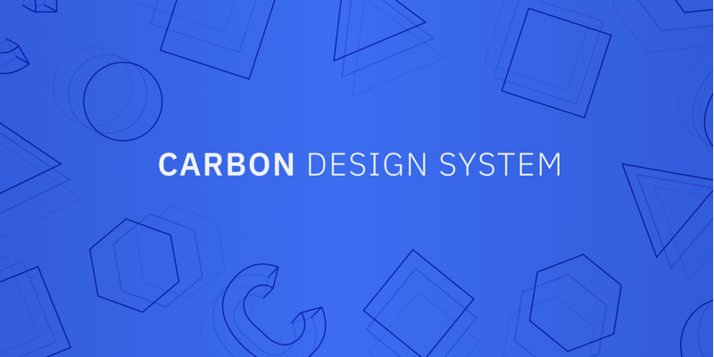
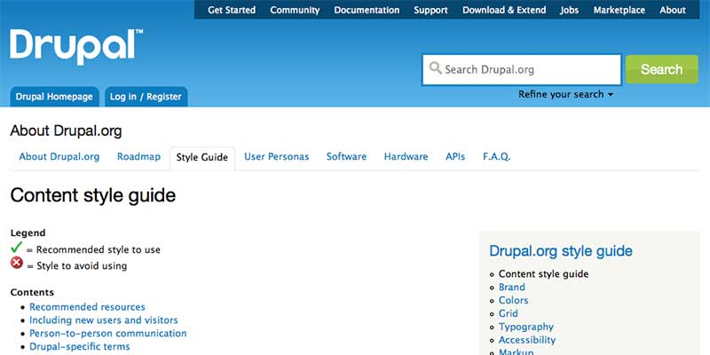
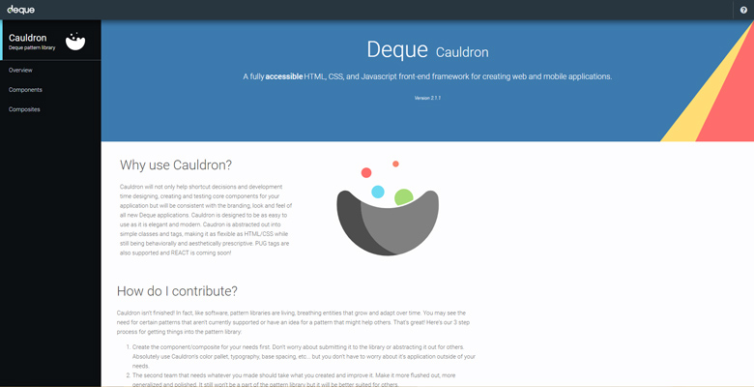
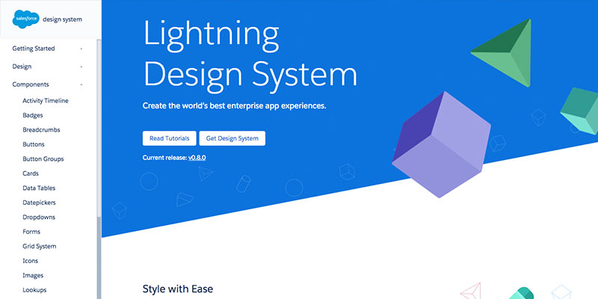
All the Cool Kids Are Doing It
Notes:
The U.S. government, IBM, Drupal, Deque, Salesforce and more all have design systems that are publicly available. Some are documented better than others—and we’ll get to some of the details later on what I think makes a good design system. I am biased because I think the place I work, Wells Fargo, has a really great mix of talent and documentation—unfortunately, it’s behind a firewall. But later on, I’ll explain a little but about our methodology without giving away any company secrets. But one of the things that impressed me most about Wells Fargo—and continues to impress me—is they’ve built accessibility into their design system. We have a component library that discusses look and feel, content, and accessibility with hopes that when developers build our apps they can just pluck user interface components that are already specked out and tested. Do they work with screen readers? How about responsive des

Slide 7
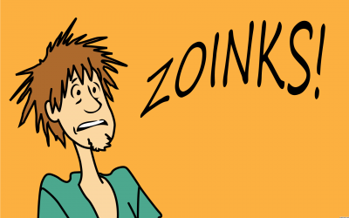
a11y is not a four letter word
Notes:
When I worked in one of my previous roles, I tried to raise this issue of reinventing the wheel, but it didn’t go very far. I hope my date picker example earlier helped explain how futile it can be when an organization tries to implement several flavors of the same thing with limited resources. There will always be that mentality among some who will say “But we’ve always done things that way.” To me it sounded like excuses. And worst of all, it helped make it very difficult to implement accessible sites and applications. Fortunately, I’m not the only one who hates hearing the same tired excuses especially when it comes to accessibility.

Slide 8

Excuses, Excuses
“Can we agree to stop making these excuses? Accessibility is a win-win situation for all involved. It’s even good for business: by making our sites accessible for everyone, we also increase our potential user base.”
“Every decision a team makes affects a site's accessibility…. if you work on the web in any capacity, accessibility is your job.”
- Laura Kalbag
Notes:
Laura Kalbag is a designer from the UK. In her book “Accessibility for Everyone” and on the web, she explains her approach to universal design and takes on the people who like to make excuses. Accessible design, she says considers the needs of people with disabilities. Universal design considers the needs of a diverse human population.
So let’s dive deeper into the excuse makers and how to respond to them.

Slide 9

No More Excuses
“Accessibility is Boring”
“We Can’t Tell If Anyone Really Benefits”
“We Don’t Know What to Do”
“It’s Too Hard and There’s Too Much to Do.
Notes:
“Accessibility is boring.” We always want to know about the coolest new framework or the shiniest new aesthetic trend. These are avoidance tactics. While our tools can be cool, we’re distracting ourselves from what really matters: why our products exist and who benefits from them.
“We can't tell if anyone really benefits.” There’s a common misconception that people with disabilities don’t use the Internet…For now, I’ll just say that it’s a load of nonsense.
“We don’t know what to do!” You’ll discover that there are many ways to approach accessibility. A few small changes can make a big difference.
“It’s too hard and there’s too much to do.” The web is always moving and changing, and so we frequently come across complications and bugs when we’re
building sites. We don’t normally give up at the first sign of an issue; we find a way around it, without compromising the experience. The same is true of accessibility; we just need to add new techniques to our toolkit.

Slide 10
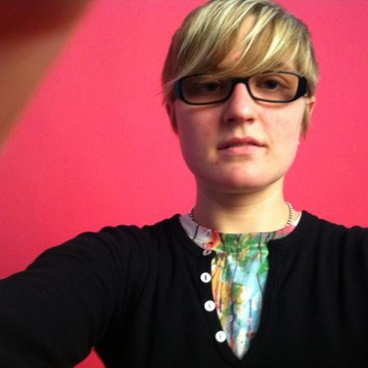
Your Product Is Inclusive When It’s Most Usable By the Widest Range of People
“Just the word accessibility casts an aura of ‘otherness’ on people who use accessibility features. Us normal people over here, and those people over there who need special stuff in order to live. Us versus them. So, I prefer to use the word ‘inclusivity’ in place of accessibility.
- Allison Shaw
Notes:
Allison Shaw is a Senior Product Designer at Zendesk. “She was previously at Yelp where she helped craft their design style guide. Accessibility is a scary word in product development. It’s such long word that it needs an abbreviation: a11y. Accessibility features are often considered “nice-to-haves,” if they’re even considered at all. I’ve been on teams that believed accessibility was an unnecessary burden that siphoned resources away from feature building.

Slide 11
What is a Design System?
Internal collaboration tool used by designers and engineers
Includes a system’s rules and principles, visual design, and code that renders user interface
End users are people actually using your product
Notes:
When she started at Yelp, they called it a style guide, but as time marched forward, the term evolved to “design system” What used to be a style guide is now called a design system, which is an internal tool used by designers and engineers that includes a system’s rules and principles, the visual design of elements, and the code that renders the user interface. The last aspect of a design system is the end-users who are actually using your product. Accessibility is another component of a design system. It doesn’t just apply to people who are blind or who are in wheelchairs. If you define accessibility only by these visible markers, you turn them into “others”—us vs. them. Not very nice. She prefers the term inclusivity, which sounds more like it’s welcoming people. Your product is inclusive when it is most usable by the widest range of people, including but not limited to people with disabilities. Inclusivity can also include people with slow internet connections, older smart phones, old monitors, people with children in their hands.
Shaw says design systems are kind of like a government of your product’s design. They embody the norms, values, and laws that every citizen tries to adhere to. Governments provide the foundation upon which great things happen. They attempt to solve universal needs so that people can go about their lives without thinking much about what it takes to keeps cities and towns running. At their best, governments work for all people. Design systems provide foundational elements like typography, grids, colors, standardized pieces of user interfaces, No matter where anyone is on your site, they know what a button looks like. Design systems are the perfect vehicle for your company’s accessibility efforts because they provide so much of the foundation upon which products are built. By weaving accessibility into the fabric of your system, your designers, engineers, all users will ultimately benefit.

Slide 12
Allison Shaw’s tips for an accessible design system
Predictable and clear
Semantic code
Be color conscious
Notes:
Predictable: Your audience spends most of its time not using your product unless your are Facebook or Google. Practically speaking, don’t be novel for the sake of being novel. Following established pattern is how you make a product intuitive, how you make people feel like they already know how to use your product without ever reading instructions. This helps you lower the cognitive load someone needs to figure out how to use your product. This helps users who have cognitive or reading disabilities or just people in a rush. Design systems aren’t the place to try out experimental user interfaces. Make your links blue, put your nav in the same place. Don’t hide important functionality behind hover effects just for the sake of minimalism. Group like objects near each other.
Semantics: As she puts it, accessible code is insanely important. If your code is not built for inclusivity, it almost doesn’t matter what your front end looks like. Use the correct code so that it’s readable by humans and machines. Write standards compliant semantic HTML and CSS, fill in with ARIA where appropriate, design for keyboard navigation. Designing and developing a logical keyboard navigation paradigm. Great keyboard control will make you a hero to people with accessibility needs AND power users alike.
Color: Perceiving color is one of mankind’s superpowers, but not all of us see color in the same way or even at all. Using color alone to distinguish one thing from another thing is problematic for people who have difficulty perceiving color. But you can easily address this by adding labels, icons, explanations, or otherwise changing visual presentation. The color contrast rule is pretty often ignored by designers aspiring to “minimalism.” As product designers, we’re not designing for ourselves—we’re designing for our customers. If people can’t see your content, they can’t read it. And if they can’t read it, they’re probably not going to give you money. As WCAG says, don’t use color alone to convey information as the sole means and ensure good contrast. One of the most common conventions is to underline a link and make it blue but there are designers who try to move away from this. One way around this is to add a caret after a link, changing the type weight or size, or you can make the underline thinner.

Slide 13

Frameworks: An Exciting Paradigm Shift
“When I started my career, most sites were built with single-use, inefficient, fragile, and inconsistent front-end codebases. Through hard-won experience and many years of collaboration and iteration, front-end developers have established more sophisticated practices for writing and organizing our code.”
- Katie Sylor-Miller
Notes:
Katie Sylor-Miller, Staff Software Engineer at Etsy, formerly Senior Front End Developer, UX at Constant Contact
Through hard-won experience and many years of collaboration and iteration, front-end developers have established more sophisticated practices for writing and organizing code. Now, there is an explosion of front-end frameworks and tooling to help you write better, more maintainable HTML, CSS, and JavaScript. This represents an exciting paradigm shift in front-end development, but the number of choices available can be overwhelming.
Your technical approach doesn’t matter as much as creating a living, breathing system that’s flexible, maintainable, stable, scalable, and successful in the long-term.

Slide 14
Keys to a Successful Design System
Consistent
Self Contained
Reusable
Accessible
Robust
Notes:
According to Sylor-Miller, the keys to a successful design system are
It’s consistent. The way components are built and managed follows a predictable pattern.
It’s self-contained. Your design system is treated as a standalone dependency.
It’s reusable. You’ve built components so they can be reused in many contexts.
It’s accessible. Applications built with your design system are usable by as many people as possible, no matter how they access the web.
It’s robust. No matter the product or platform to which your design system is applied, it should perform with grace and minimal bugs.

Slide 15
Let’s Look Deeper
Consistency
Example: Airbnb’s “Mostly Reasonable” rules for CSS, JavaScript, and React
The Importance of a Style Guide by Harry Roberts
Self-contained
Reusable
Example: Bootstrap
Accessible
Notes:
Consistency - define the rules of your system, document them, and ensure that everyone follows them. When you have clearly documented code standards and best practices in place, designers and developers from across your organization can easily use and, more importantly, contribute to your design system.
Code style- grammar rules of syntax and semantics for your code, syntax is the set of rules for structuring and formatting your code. She points to Airbnb’s “Mostly Reasonable” rules for CSS, JavaScript, and React
Self-contained - enables versioned releases of your code, share code across multiple teams, products, and codebases, provides infrastructure for a robust front-end testing architecture, forms a foundation for a living style guide website
Reusable - Bootstrap, the most-used front-end library of all time, powers hundreds (if not thousands) of websites because it was architected with reusability in mind. To be reusable and scalable, patterns need to be modular, composable, generic, and flexible.

Slide 16

Building Your Design System
“For too long, accessibility, or a11y, has been misunderstood as building sites for a small group of users of assistive technology—a blind person using a screen reader—and far too often dismissed as too complex, too time-consuming, or “not our customers.” Accessibility, however, is not just for a single, small group, but for an estimated 15% of people worldwide (56.7 million people in America alone) with a wide spectrum of permanent or temporary visual, auditory, motor, and cognitive impairments.”
- Diana Mounter
Notes:
Diana Mounter, Product Designer and Design Systems Lead at Github talks about using a pilot project. It can be an imaginary project that you build in a sandbox environment and a testing ground for testing your new design system.
Potential for common components. Does this pilot have many components that can be reused in other products?
Potential for common patterns. Does this pilot have many patterns that can be reused in other products?
High-value elements. Even if uncommon, is there a component or pattern with high business value at the heart of this project? We’re talking about elements that are integral to a flow or audience with unusually high value for the organization.
Technical feasibility. How simple is a technical implementation of the design system? Is a large refactor required?
Available champion. Will someone working on this product see it through and celebrate/evangelize using the design system (and even contribute to it)?
Scope. Is this work accomplishable in our pilot timeframe of [3–4 weeks] (insert your timing here)?
Technical independence. Is the work decoupled enough from other legacy design and code that there are clear start and end points?
Marketing potential. Will this work excite others to use the design system?
There was one downside to building the new design system alongside a product—it ended up being biased to the needs of that product. Afterward, it needed further development to work for the whole Etsy application. Working in a silo with minimal outside feedback allowed us to make progress quickly, but meant that we had to work harder to encourage other teams to adopt the design system.

Slide 17
How to Create a Design System that Incorporates Accessibility
Inventory Existing User Interface Components
Organize
Test Components for Color
Test Components for Keyboard Accessibility
Test Components with Screen Readers
Notes:
Create an inventory of existing different patterns, colors, text styles and assets.
Then begin testing. Then begin documenting. Include in your documentation code standards and guidelines for common a11y best practices such as using larger, legible text sizes, always associating a form field with a label, and properly adding alt text attributes to images, to name a few.

Slide 18
Example: eBay
https://ebay.gitbooks.io/mindpatterns/
Organization
Contents
Principles (POUR)
Notes:
Organize by categories. eBay organizes its components into Messaging, Input, Navigation, and Disclosure
Messaging includes things like alerts, flyouts, form validation, inline notice,
Input includes things like checkboxes, autocomplete, buttons, radio buttons
Navigation includes things like breadcrumbs, links, pagination
Disclosure includes things like accordions, carousels, dialogs, tabbed panels, tooltips
Pattern Contents
Every pattern includes:
Overview
Working examples
Best practices
Interaction design
Developer guide
ARIA Reference
Pattern Principles
There are 4 guiding principles of accessibility, collectively know as POUR:
Perceivable: People experience content in different ways (sight, hearing, and touch). Content needs to be transferable into recognizable (or perceivable) formats.
Operable: Content needs to be navigable (or operable) by multiple methods—not just a mouse
Understandable: Web content needs to be understandable. Language should be simple and concise; functionality should be consistent and intuitive.
Robust: Create web content that works for all (or most!) technologies. This includes operating systems, browsers, and mobile devices.
From a developer perspective, Operable and Robust are the most important principles!

Slide 19
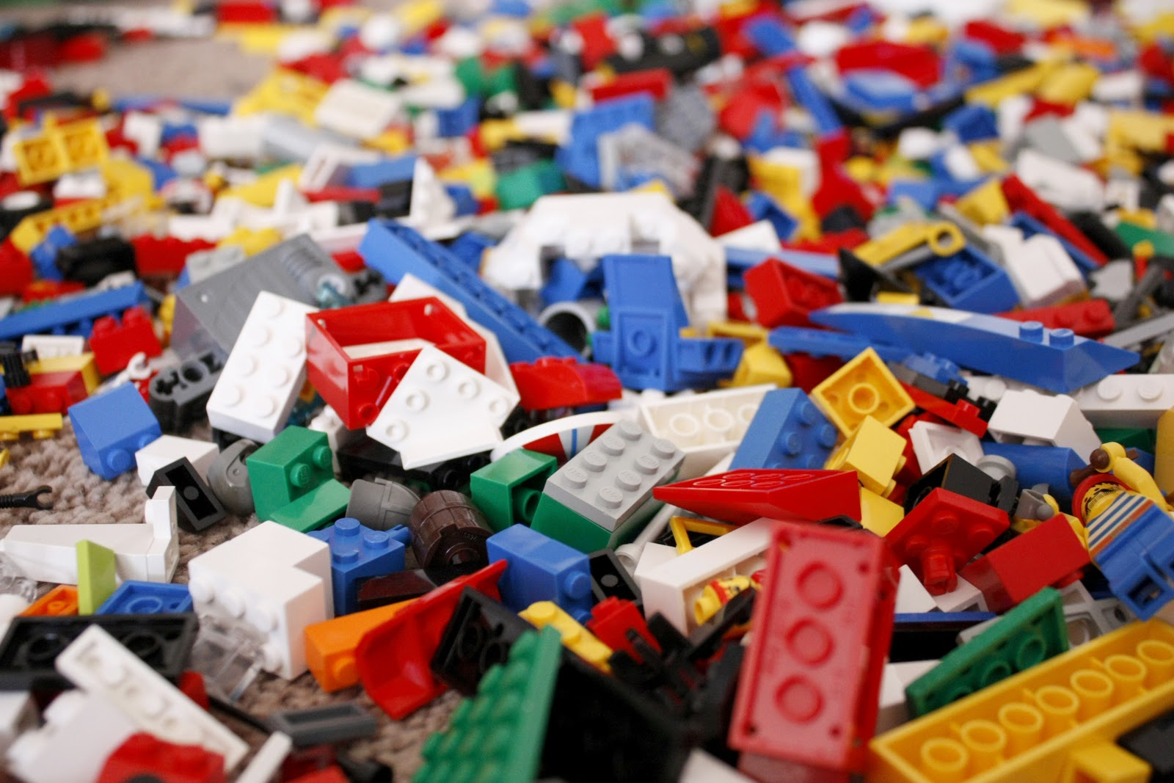
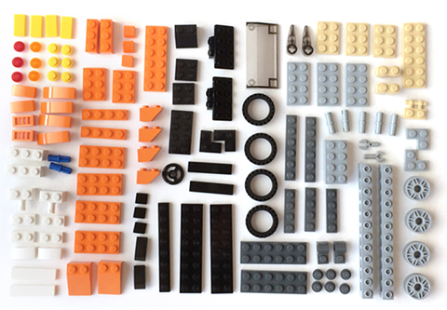
Organizing Parts for a Product
MESSY
ORGANIZED
Notes:
Design thinking refers to creative strategies designers use during the process of designing. Many design thinkers like to employ the use of Legos to help generate innovative ideas and solutions and share ideas within the context of organizational strategy.
On your left Here’s what you look like today: inconsistent without a system
On your right Here’s what you look like tomorrow: cohesive using a system

Slide 20
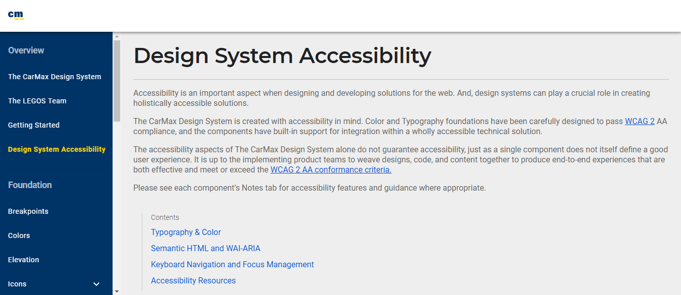
Design System Example: CarMax
Notes:
There are many organizations that combine the concept of Legos with design systems. The national used car retailer, CarMax, for example, has a design system that not only incorporates accessibility, but has a Legos team. Their goal is deliver a consistent user experience through a single source of brand styles for all product teams to use (colors, typography, icons); UI components (buttons, form elements, car tiles); and UX patterns (searching, completing a form, saving a car). The system is not only for consistency but for speed, as it allows product teams to build faster. And their design system also includes Typography, Color, Semantic HTML and ARIA, keyboard Navigation, and Focus Management

Slide 21
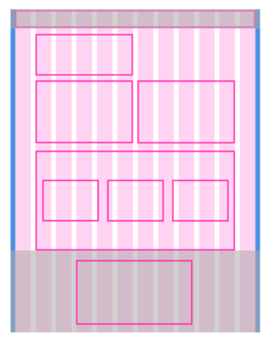
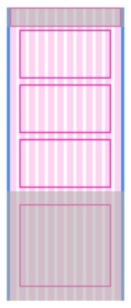
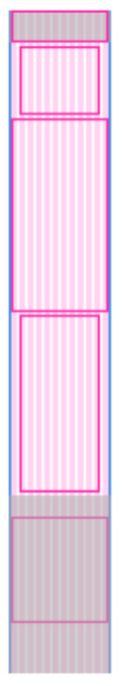
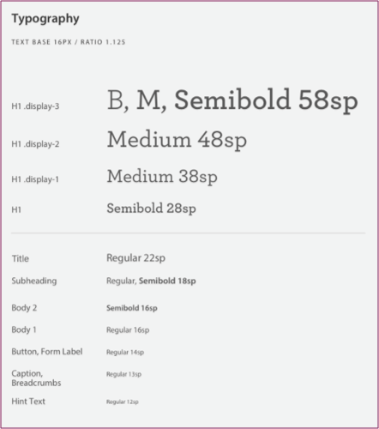
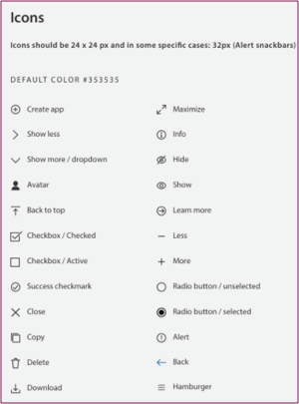
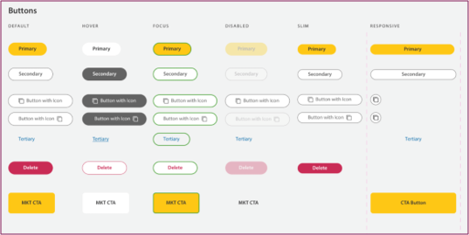
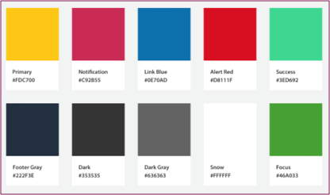
Organizing Visual Design Parts for a Product
Notes:
In “Communicating Design: Developing Web Site Documentation for Design and Planning” Dan Brown said with a modular approach, you treat wireframes as Lego kits, assembling screens from individual, sharable pieces.
Headers, navigation elements, and footers are common components.

Slide 22
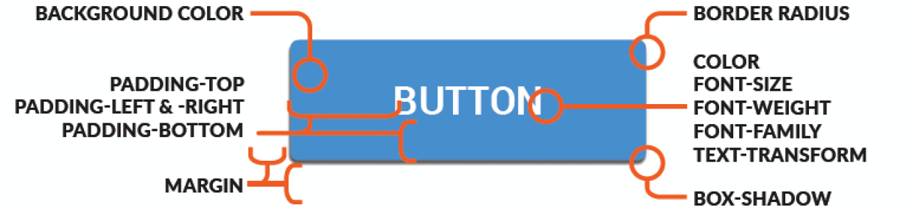
Behold the Button!
Notes:
The button is one of the most basic forms of user interface.. Buttons help us navigate, but also set a stylistic tone. Like most screen elements, each button contains a large amount of detail in its specification
And each button usually has several different states as well as different functionalities and hierarchies
Multiply all of these detailed specifications for all of our parts on all of our screens — and things can get a little complicated

Slide 23
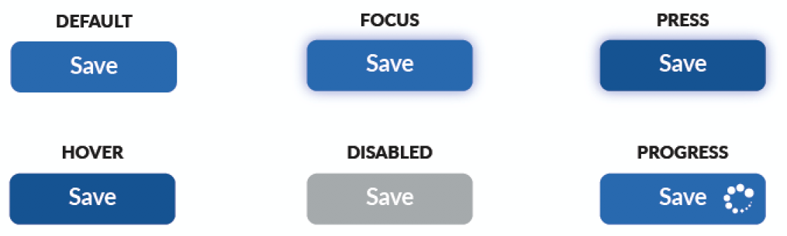
Button States
Notes:
Button states include Active/Enabled, Hover, Focus, Pressed, and Disabled

Slide 24
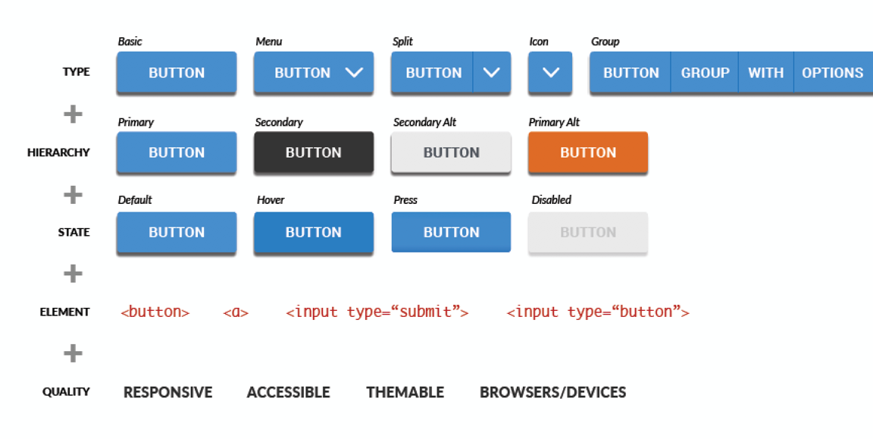
Button Hierarchies
Notes:
Example of button hierarchies

Slide 25

Assembling Your UX Team
Researcher
Visual Designer
Interaction Designer
Content Strategy
Accessibility Specialist
Front End Developer
Notes:
The researcher gathers user requirements, collects insights into the user, may use Web Analytics, and advanced surveying of users
The visual designer or graphic designer chooses images, colors, symbols and typography, creates visual components, designs composition and rules, grid systems
The interaction designer creates wireframes, site structures,. Sometimes the interaction designer and visual designer are the same person
Content strategy allows for usable content to be created, published and governed. Therefore, content strategists help organize content, write in plain language, come up with a writing style guide, evaluate content and conduct audits, define an editorial process and governance. They may even get to decide what the character limit is on a button.
The Front End Developer does the coding, chooses an already existing JavaScript framework and how to incorporate. This role is the only one touching the code for CSS, HTML and the client side of JavaScript
The accessibility specialist works with all the other team members to make sure the design and code is WCAG compliant. The importance of consistent navigation and iconography, when to use ARIA, ensuring semantically correct code. Testing color contrast ratios, content with screen readers. It helps if the accessibility specialist educates the other team members.
Together, they create a design system, document user interface components,

Slide 26
UI Component Specifications
Business Need
Function
Appearance
Content
Accessibility
Notes:
Business need defines their purpose and when and how component is used. For example, buttons are needed to trigger actions like submit form information, print a screen, display a menu or other information
Function defines things like structure, interaction design, and states. Structurally buttons can have a text label, images/icons, or a combination of text and images/icons. Buttons might also contain a menu if they contain a down arrow icon. Buttons can be enabled, disabled, active/pressed. They have a focus state and a hover state. They should be reachable by keyboard or mouse. At certain breakpoints, a button may change in appearance.
Appearance discusses different styles, dimensions, colors, padding, font, corner radius, padding, borders, opacity. What are the design rules? What are the colors - in all states
Content discusses character limits, using active voice in how worded, consistency. Examples: Submit, Continue, Apply, Save. Can also include rules about alternative text or hidden text
Accessibility includes rules that touch on the other specs. For example, in some sort of tabular data scenario, you might have button appear several times on one screen that says “View” and visually that makes sense in context, but behind the scenes the button may need to be announced by a screen reader as a “View Row 1” You must ensure the color scheme passes minimum color contrast ratio. You must ensure disabled state buttons are not focusable. You want to ensure responsive design works right for resizing text. You want to make sure whenever possible buttons use the <button> tag. You want to ensure aria is used if a button is a toggle button or aria-expanded is used if the button triggers a menu. Or if you have a help button that just contains a question mark that it has an aria label.. So accessibility would address Is their a native HTML element for it?
Properties
HTML attributes
Aria techniques if applicable
Focus management
Keyboard interaction
Visible focus
Color
Images
Rules about resizing text
Notes for developers
Sample coding

Slide 27
Resources
Accessibility for Everyone, Laura Kalbag
Accessibility in Design Systems, Allison Shaw
Building a Design System, Katie Sylor-Miller
Inclusive Components, Heydon Pickering
Building Blocks, Zurb Foundation
ZenDesk Garden
Lightning Design System (SalesForce)
CarMax Design System
eBay Mind Patterns

